Slide 1


Introduction to Simulation
IE406
UTK/ISE
Mohammad Ramshani
University of Tennessee

Slide 2
Simulation?
Methods and applications to imitate or mimic real systems – often via computer experiments
Applications:
ISE, Education, Military, Healthcare, Entertainment
Scientific Modeling to study natural systems
Simulation is often used when
We cannot use the real system (not accessible, dangerous costly)
Examples?

Slide 3
Examples?

Slide 4
Simulation History
Buffon’s “Needle Experiment” 1777
Computer Based Simulation
WWII
First computer simulation
Jon Von Neumann and Stanislaw Ulam
Behavior of neutrons
“The Roulette Wheel technique” to solve certain problems in the design of the hydrogen bomb (still analytically intractable)
Keith D. Tocher General Simulation Program (GSP)
Notes:
Needle experiment
http://web.mit.edu/urban_or_book/www/book/chapter3/3.3.1.html
Keith Douglas Tocher, a professor of operational research at the University of Southampton, developed the General Simulation Program (GSP), the first general-purpose simulator, as a tool for systematically building a simulation of an industrial plant that comprises a set of machines, each cycling through states such as busy, idle, unavailable, and failed.
Important history link
https://www.informs-sim.org/wsc09papers/028.pdf

Slide 5
System
ISE people, we use simulation to study Systems
A system is a regularly interacting or interdependent group of units forming an integrated whole. – Wikipedia
Examples
Manufacturing facilities
Bank operation
Transportation/logistics/distribution operation
Hospital facilities (emergency room, operating room, admissions)
Computer network
Business process (insurance office)
Emergency-response system
Shipping ports
Military combat, logistics
What is a System?

Slide 6
How to Study Systems
Mainly Study Systems to:
Measure
Improve
Design
Control
Why?
Learn about the system
But often impossible in reality with actual system
System doesn’t exist
Would be disruptive, expensive, dangerous
How?
By implementing a Model over time

Slide 7
Models
Set of assumptions/approximations about how system works
Why do we need models?
Study model instead of real system
usually much easier, faster, cheaper, safer
Can try wide-ranging ideas with model
Make your mistakes on the computer where they don’t count, rather than for real where they do count
Often, just building model is instructive – regardless of results
Model validity (any kind of model … not just simulation)
Care in building to mimic reality faithfully
Level of detail
Get same conclusions from model as you would from system
Models?

Slide 8
Types of Models
Physical (iconic) Models
Tabletop material-handling models
Mock-ups of fast-food restaurants
Flight simulators
Logical (mathematical) Models
Approximations, assumptions about system’s operation
Intended to promote understanding of the real system
Simplified (selective)
To learn about model behavior

Slide 9
Logical Models
Simple systems (inherently or translatable)
Mathematical analysis → results (exact or acceptable approximation)
Queueing theory
Differential equations
Linear programming
Complex systems (too complex for analytical models)
Cannot be validly represented by simple analytic model
Risk of over-simplifying
Type III error – working on the wrong problem
A tool to study complex systems through complex models

Slide 10
Computer Simulation
Methods for studying wide variety of models of systems
Numerically evaluate on computer
Use software to imitate system’s operations and characteristics, often over time
Used to study simple models, but should not be used if an analytical solution is available
Real power of simulation – studying complex models

Slide 11
Popularity of Simulation
Has been consistently ranked as the most useful, popular tool in area of operations research / management science
1979: Survey 137 large firms, which methods used?
1. Statistical analysis (93% used it)
2. Simulation (84%)
3. Followed by LP, PERT/CPM, inventory theory, NLP, …
1980: (A)IIE O.R. division members
First in utility and interest — simulation
First in familiarity — LP (simulation was second)
1983, 1989, 1993: Longitudinal study of corporate practice
1. Statistical analysis
2. Simulation

Slide 12
Popularity of Simulation (cont’d.)
1989: Survey of surveys
Heavy use of simulation consistently reported
Gartner Top 10 Strategic Technology Trends for 2019
Support specific business outcomes
Real time monitoring and control (Digital Twins)
Advanced big data analytics and AI to drive new business opportunities
Evaluate “what if” scenarios
Improvements in hardware/software have made simulation even more attractive over time

Slide 13
Advantages of Simulation
Flexibility to model things as they are (even if messy and complicated)
Provide feedbacks when designing systems
Evaluating alternatives without physically building them
Significant cost reductions
Allows uncertainty, non-stationarity in modeling
The only thing that’s for sure: nothing is for sure
Danger of ignoring system variability
Study the problem with different levels of abstraction
Top-down technique
Observe unexpected phenomena
Notes:
http://web.cs.mun.ca/~donald/msc/node6.html
One of the primary advantages of simulators is that they are able to provide users with practical feedback when designing real world systems. This allows the designer to determine the correctness and efficiency of a design before the system is actually constructed.
Another benefit of simulators is that they permit system designers to study a problem at several different levels of abstraction. By approaching a system at a higher level of abstraction, the designer is better able to understand the behaviours and interactions of all the high level components within the system and is therefore better equipped to counteract the complexity of the overall system. This complexity may simply overwhelm the designer if the problem had been approached from a lower level. As the designer better understands the operation of the higher level components through the use of the simulator, the lower level components may then be designed and subsequently simulated for verification and performance evaluation. The entire system may be built based upon this ``top-down'' technique. This approach is often referred to as hierarchical decomposition [32] and is essential in any design tool and simulator which deals with the construction of complex systems. For example, with respect to circuits, it is often useful to think of a microprocessor in terms of its registers, arithmetic logic units, multiplexors and control units. A simulator which permits the construction, interconnection and subsequent simulation of these higher level entities is much more useful than a simulator which only lets the designer build and connect simple logic gates. Working at a higher level abstraction also facilitates rapid prototyping in which preliminary systems are designed quickly for the purpose of studying the feasibility and practicality of the high-level design.

Slide 14
Simulation and Computers
Advancements in computing/cost ratios
Estimated that 75% of computing power is used for various kinds of simulations
Dedicated machines (e.g., real-time shop-floor control)
Advancements in simulation software
Far easier to use (GUIs)
No longer as restrictive in modeling constructs (hierarchical, down to C)
Statistical design & analysis capabilities

Slide 15
Disadvantages of Simulation
Don’t get exact answers, only approximations, estimates
Also true for many other modern methods
Get random output (RIRO) from stochastic simulations
Statistical design, analysis of simulation experiments
Exploit: noise control, replicability, sequential sampling, variance-reduction techniques
Catch: “standard” statistical methods seldom work

Slide 16
Different Kinds of Simulation
Static vs. Dynamic
Does time have a role in model?
Continuous-change vs. Discrete-change
Can “state” change continuously, or only at discrete points in time?
Deterministic vs. Stochastic
Is everything for sure or is there uncertainty?
Most operational models:
Dynamic, Discrete-change, Stochastic

Slide 17
The Origins of Simulation: Buffon’s Needle Problem
Dropping a needle into a series of parallel lines
What is the probability that the needle lies across a line
Length of the needle is smaller than the distance between two lines

Slide 18
Why Is It Important?
Buffon needle problem seems silly now, but has important simulation features:
Experiment to estimate something hard to compute exactly (in 1733)
Randomness, so estimate will not be exact; estimate the error in the estimate
Replication (the more the better) to reduce error
Sequential sampling to control error — keep tossing until probable error in estimate is “small enough”

Slide 19

Using Computers to Simulate
General-purpose languages (C, C++, C#, Java, MATLAB, FORTRAN, others)
Tedious, low-level, error-prone
But, almost complete flexibility
Support packages for general-purpose languages
Subroutines for list processing, bookkeeping, time advance
Widely distributed, widely modified
Spreadsheets
Usually static models (only very simple dynamic models)
Financial scenarios, distribution sampling, SQC

Slide 20
Using Computers to Simulate (cont’d.)
Simulation languages
GPSS (developed by IBM), SLX, SIMAN (on which Arena is based, included in Arena)
Popular, some still in use
Learning curve for features, effective use, syntax
High-level simulators
Very easy, graphical interface
Domain-restricted (manufacturing, communications)
Limited flexibility
Notes:
GPSS resembles a LEGO structure where blocks are chosen by the modeller for specific functions to imitate a particular system.^{[10]}
The language is neither procedural, object-oriented or functional programming. The world is simulated with entities moving through the model.^{[11]} These entities, called Transactions, are envisioned as moving from Block to Block, where a Block is a line of code and represents unit actions that affects the Transaction itself or other entities.
SLX is a Windows-based system for developing discrete event simulations. It is not a graphically-based modeling system, but a modeling language.

Slide 21
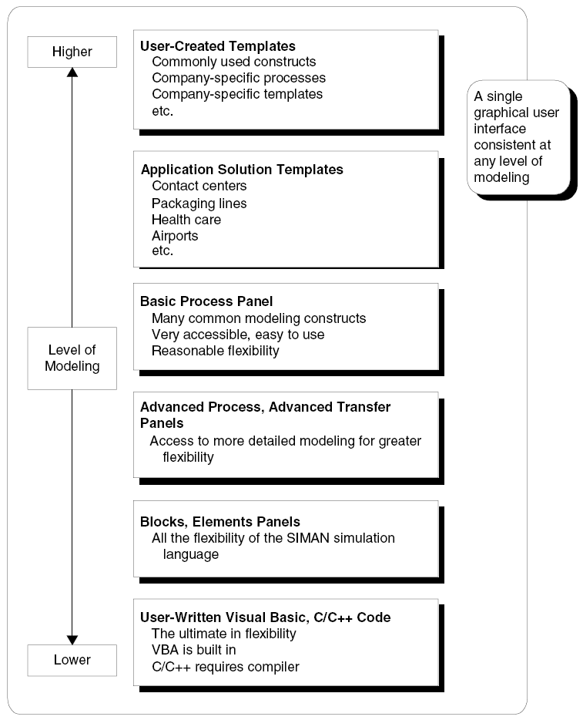
Where Arena/AnyLogic Fits In
Hierarchical structure
Multiple levels of modeling
Mix different modeling levels together in same model
Often, start high then go lower as needed
Get ease-of-use advantage of simulators without sacrificing modeling flexibility

Slide 22
How about AnyLogic?
Java based
Notes:
Code blocks are represented by graphical blocks to ease the programming
Then you can easily drag and drop them, link them and slightly modify them to make your model
Those blocks are blocks of code → You can edit them by adding more lines of code into them!

Slide 23
When Simulations are Used
Use of simulation has evolved with hardware, software
Early years (1950s – 1960s)
Very expensive, specialized tool
Required big computers, special training
Mostly in FORTRAN (or even Assembly)
Processing cost as high as $1000/hour for a sub-PC level machine

Slide 24
When Simulations are Used (cont’d.)
Formative years (1970s – early 1980s)
Computers got faster, cheaper
Value of simulation more widely recognized
Simulation software improved, but still languages to be learned, typed, batch processed
Often used to clean up “disasters” in auto, aerospace industries, e.g.,
Car plant; heavy demand for certain model
Line underperforming
Simulated, problem identified
But demand had dried up — simulation was too late

Slide 25
When Simulations are Used (cont’d.)
Recent past (late 1980s – mid 2000s)
Microcomputer power
Software expanded into GUIs, animation
Wider acceptance across more areas
Traditional manufacturing applications
Services
Health care
“Business processes”
Still mostly in large firms
Simulation is often part of “specs”

Slide 26
When Simulations are Used (cont’d.)
Present
Proliferating into smaller firms
Becoming a standard tool
Being used earlier in design phase
Real-time control (digital twins)
Simulation & Big Data & AI
Future
Integration with other applications for visualization, analysis
Network sharing of data in real time
Internet-enabled distributed model building, execution
Specialized vertical “templates” for specific industries, firms
Better model re-usability, operational decision making
Automated statistical design, analysis

